Slide 1
Glycogen Metabolism

Slide 2
Learning Objectives
Evaluate how the structure of glycogen allows for compact but accessible storage of glucose molecules.
Understand how glycogen synthesis and glycolysis are regulated by intracellular metabolites.
Explain how protein phosphorylation regulates glycogen synthase and glycogen phosphorylase activities and how extracellular signals affect glycogen metabolism.
Assess the tissue-specific roles of insulin, adrenaline and glucagon in glycogen storage.
Distinguish between the functions of glycogen in liver, adipose and muscle and evaluate how alterations in glycogen metabolism affect the physiological functions of these tissues.
Explain how glycogen storage diseases can occur and how specific genes result in different pathophysiologies depending on both the gene, and tissue where it is expressed

Slide 3
Quiz Question #1
What process is the breakdown of glycogen in the cell
Glycogenesis
Glycogenolysis
Glucolysis
Gluconeogenesis
Notes:
Answer is B

Slide 4
Quiz Question #2
Why is carbohydrate loading a strategy for endurance athletes
More fat is stored making more lipids available during exercise
More glycogen is generated making more carbohydrates available during exercise
Less fat is stored, improving insulin sensitivity
Less glycogen is stored, forcing the cells to rely on glycolysis
Notes:
Answer is B

Slide 5
Quiz Question #3
A lack of myocellular glycogen would affect
Aerobic glycolysis
Anaerobic glycolysis
Both
Neither

Slide 6
Current Grade Status
Notes:
36 way tie!

Slide 7
Can anaplerosis regulate fructose metabolism
Why or why not? Sketch this out as a diagram on the piece of paper

Slide 8
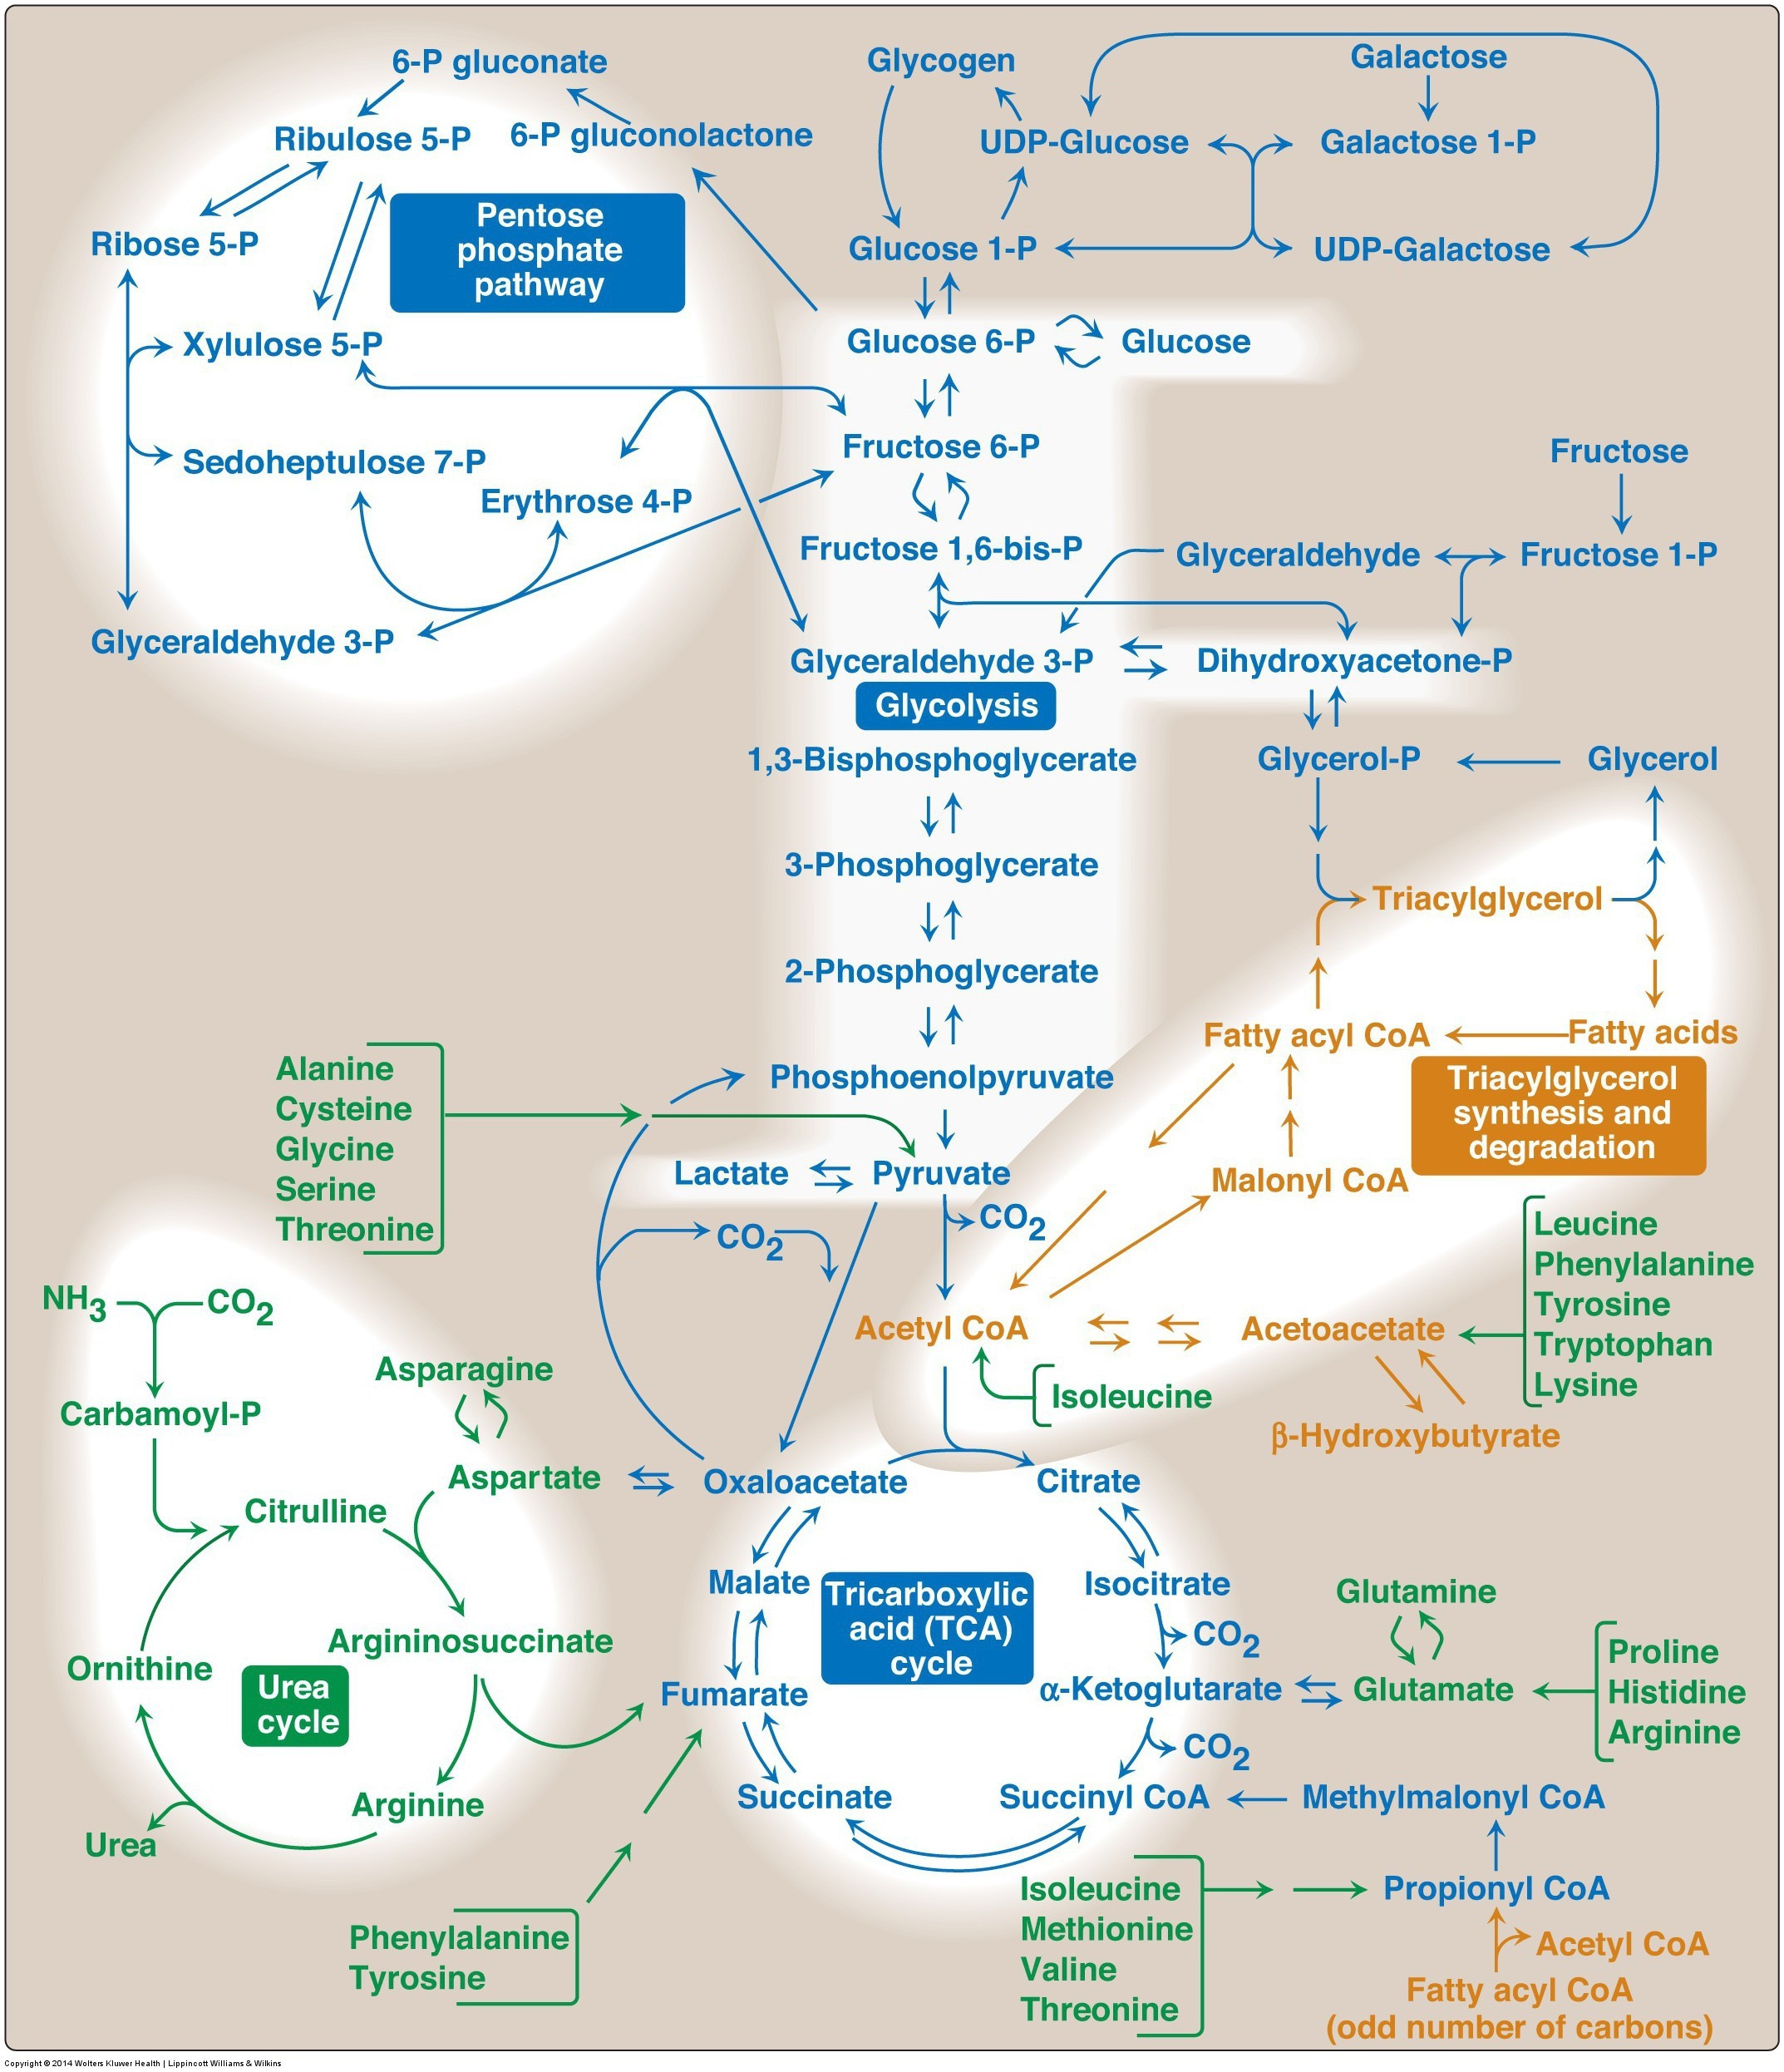
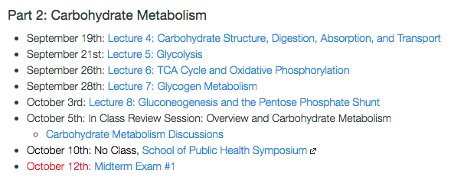

Slide 9
Fates of Glucose-6-Phosphate
Glycogenesis
Pentose Phosphate Pathway

Slide 10
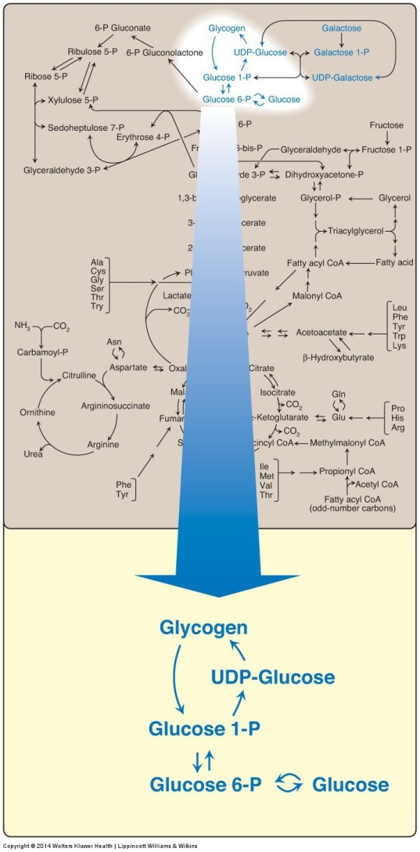
Glycogen Metabolism is Easy!
Glycogen Phosphorylase
Glycogen Synthase

Slide 11
Structure of Glycogen
Notes:
Why do you think there are all these branches?

Slide 12
What polysaccharide is glycogen most similar to?
Amylose
Amylopectin
Cellulose
Glucose
Notes:
Answer is B amylopectin

Slide 13
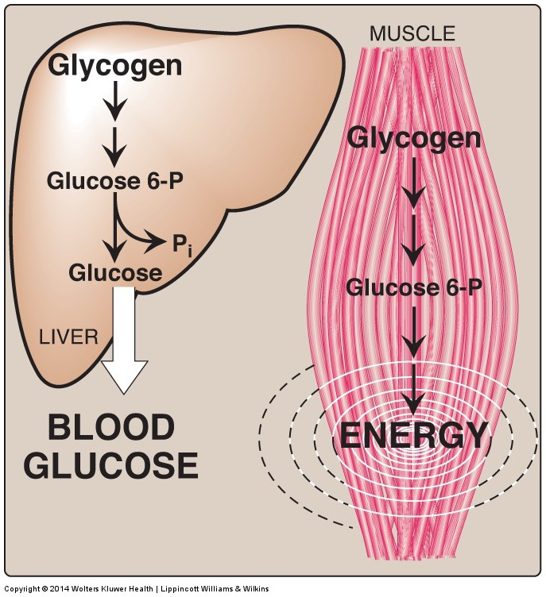
Tissue-Dependent Roles in Glycogen Metabolism
Once G6P is made, how come liver releases it, but muscle uses it for energy?
Notes:
What if G6Pase didn’t function correctly?

Slide 14
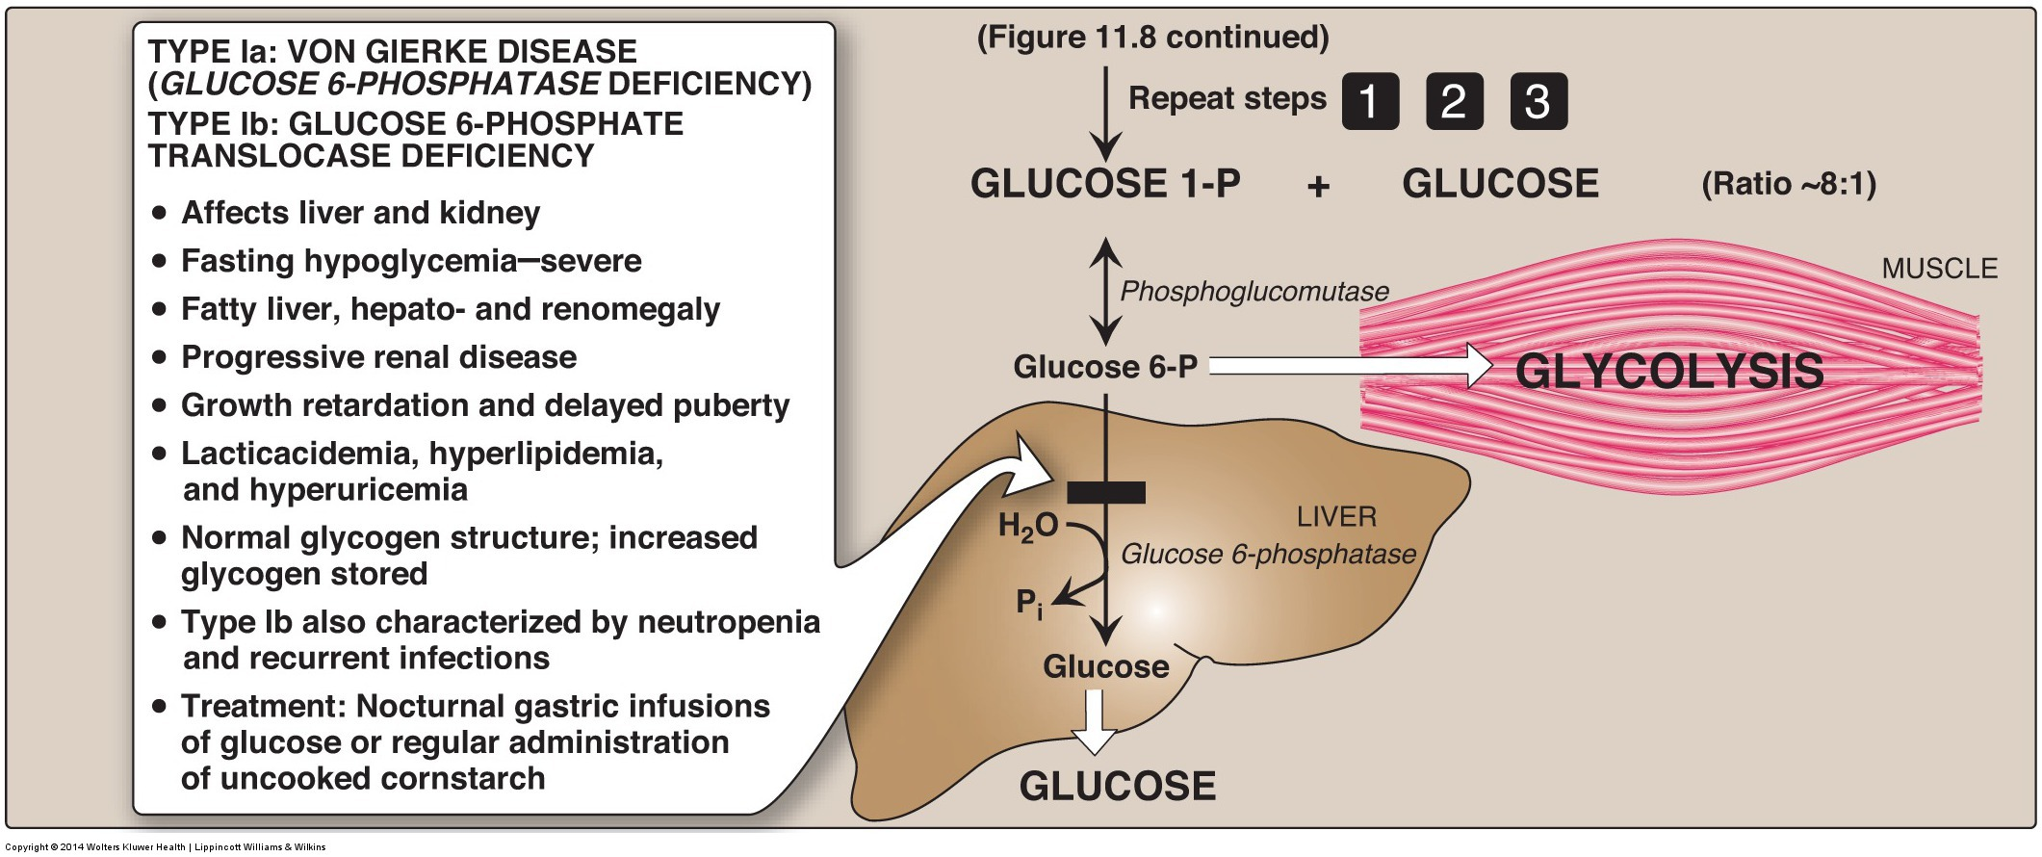
Glycogen Storage Diseases

Slide 15
How To Remove Branch Points
This is catalyzed by a single enzyme called AGL

Slide 16
Cori’s Disease
Mutations in debranching enzyme (AGL)
Single gene in all tissues, autosomal recessive
Mutations result in:
Buildup of highly branched glycogen
Hypoglycemia
Hepatomegaly (enlarged liver)
Hyperlipidemia
Poor muscle tone (hypotonia)
Muscle degeneration (myopathy)
Weakened hearts (cardiomyopathy)
Can affect muscle/liver/heart differentially, unknown why

Slide 17
Glycogen Storage Diseases
Cori’s
Her’s
McArdle
G6Pase deficiency:
von Gierke’s disease
Tarui’s Disease

Slide 18
Why would muscle PFK1 deficiency be a glycogen storage disease?
Discuss amongst yourselves
Would this be similar to liver PFK1 deficiency

Slide 19
Regulation of Glycogenolysis

Slide 20
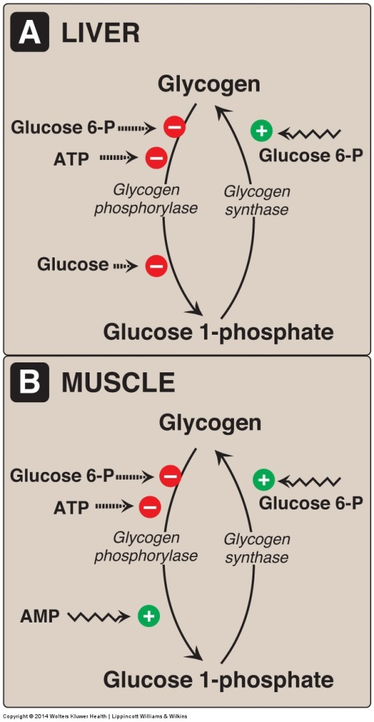
Glycogen Phosphorylase Releases Most Glucose Molecules
Note that muscle and liver have different isoforms of glycogen phosphorylase and therefore can be regulated differently.
Why are these differences advantageous?

Slide 21
Glucagon and Epinephrine
Quick review

Slide 22
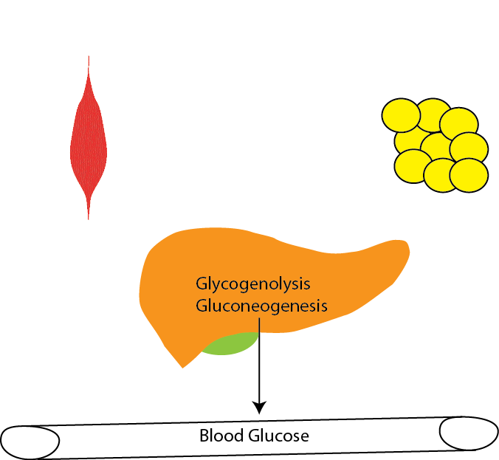
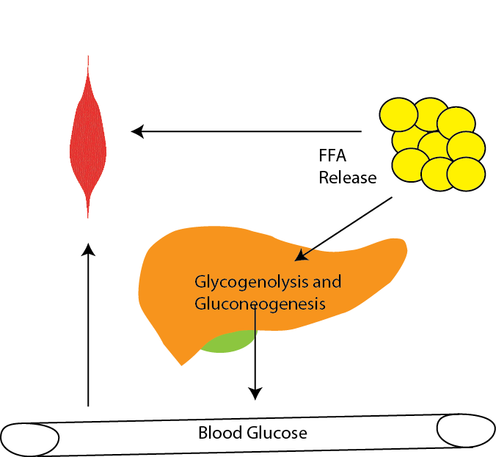
Physiology of Glucagon vs Adrenaline
Glucagon
Epinephrine
Raise Blood Glucose
Provide Glucose to Muscle

Slide 23
Glucagon

Slide 24
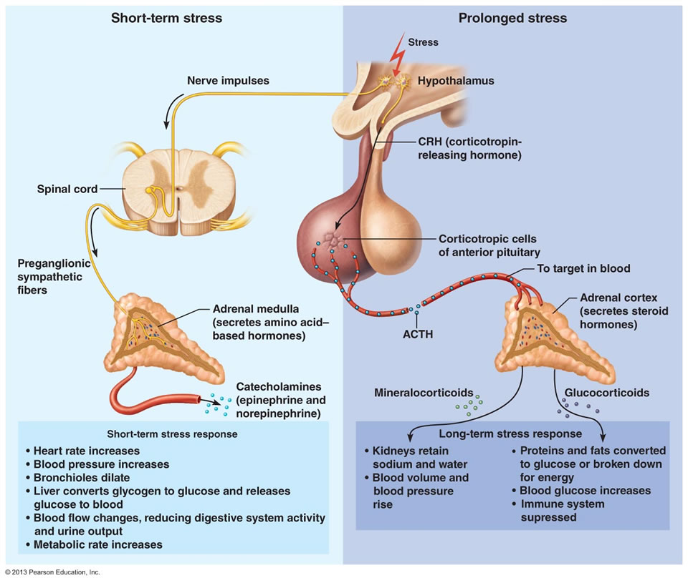
Adrenaline Release

Slide 25
Two Hormones that Stimulate Glycogenolysis and Gluconeogenesis
Glucagon
Epinephrine
Released by low glucose from alpha cells of the pancreas
Receptors in liver
Activates cAMP/PKA signaling
Neuronal release from adrenals in response to short term stress
Receptors in muscle, liver and fat
Activates cAMP/PKA signaling

Slide 26
Adrenergic Signaling Effects on Glucose/Glycogen
Glucagon
Epinephrine
Liver
Blocks glycolysis (PFK2/PK)
Stimulates gluconeogenesis (FBPase)
Blocks glycogenesis (GS/PhA)
Stimulates glycogenolysis (GS/PhA)
Muscle/Fat
Very little effect on anything almost no Glucagon receptors
Liver
Blocks glycolysis (PFK2/PK)
Stimulates gluconeogenesis (FBPase)
Blocks glycogenesis (GS/PhA)
Stimulates glycogenolysis (GS/PhA)
Muscle/Fat
Positive effect on glycolysis
No appreciable gluconeogenesis
Blocks glycogenesis (GS/PhA)
Stimulates glycogenolysis (GS/PhA)

Slide 27
Why is there no effect of adrenaline on glycolysis in muscle
Muscle doesn’t have PFK-2 activity
Adrenaline do not activate PKA in muscle
Muscle PK/PFK-2 can’t be phosphorylated by PKA
There are no Adrenaline receptors in muscle

Slide 28
Why is there no appreciable gluconeogenesis in muscle?
There are at least four differences in muscle glucose metabolism that make the production and release of glucose from muscle inefficient, can you think of them?
Notes:
Lack of glucose transporters in fasting state
Extremely efficient phosphorylation (trapping) of glucose
Inability to slow glycolysis
Inability to dephosphorylate G6P to glucose

Slide 29
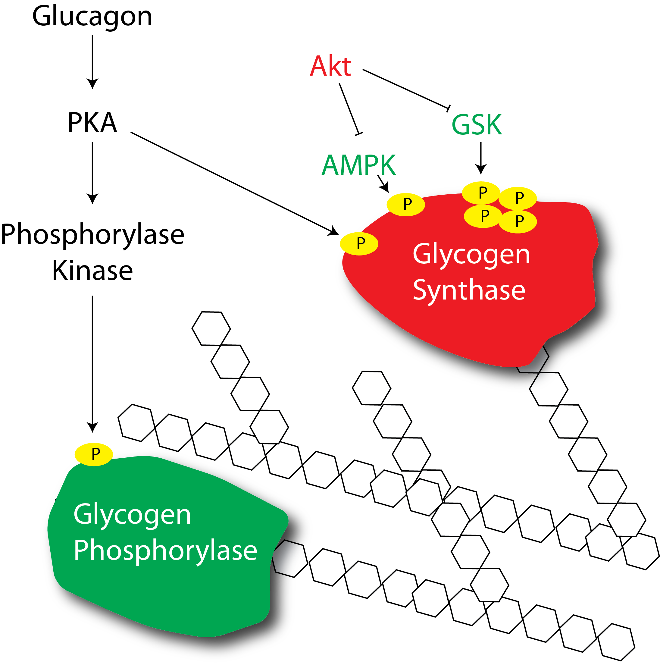
How does glucagon or adrenaline regulate glycogenolysis?

Slide 30
Defects in glycogen phosphorylase
Muscle phosphorylase
Liver phosphorylase
McArdle’s disease
Rhabdomyolysis
Second wind phenomena
Treated by high protein diets
Her’s disease
Hypoglycemia
Hepatomegaly
Hyperlipidemia
Treated by avoiding fasting, or frequent dextrose/cornstarch feeding through the night
Notes:
Second wind is due to increased ability to use lipids and proteins as an energy source, but these take some time to mobilize (usually feel better after about 10 mins of aerobic exercise)

Slide 31
Insulin

Slide 32
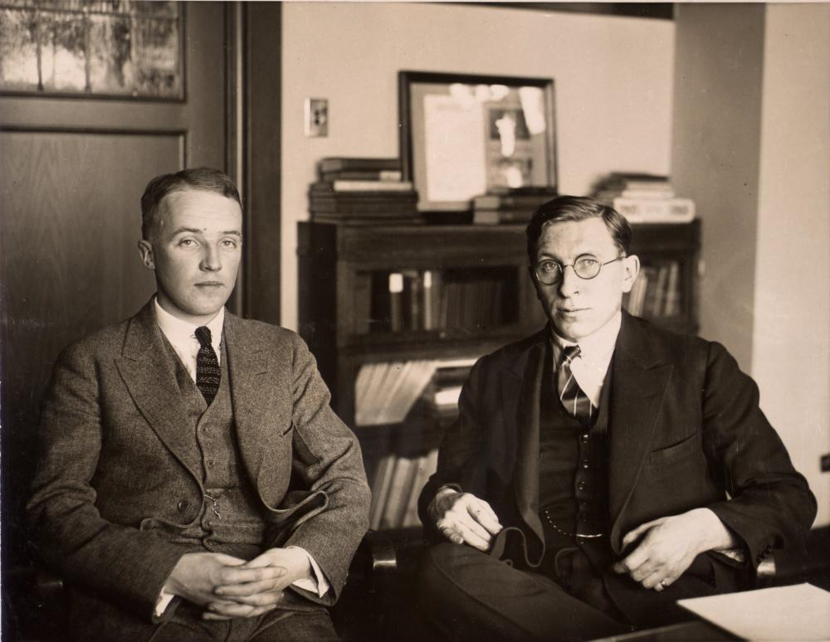
The Discovery of Insulin
Notes:
1889 von Mering and Minkowski (Pancreatectomy mimics disease)
Banting was a surgeon adept at pancreatectomizing dogs, Best was a lab technician who was very good at measuring blood glucose. MacLeod provided them lab space at the University of Toronto

Slide 33
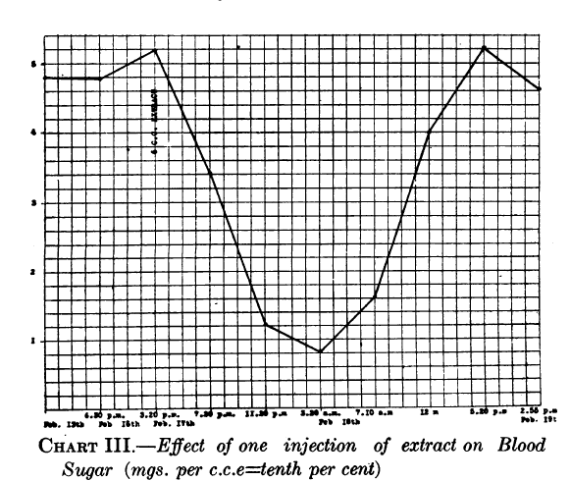
The Discovery of Insulin
Banting et al. 1922
Notes:
Insulin was discovered by Frederick Banting and his colleagues at the University of Toronto in 1921. They performed experiments in which they injected extracts
from pancreas fractions into dogs which had their pancreas’ surgically removed. They showed that a secreted substance from the pancreas lowered blood glucose
in these dogs (Frederick G. Banting and Best 1922). This is an image of dog pancreas isolate injected into a diabetic child

Slide 34
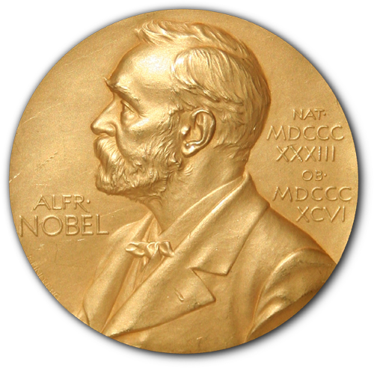
Nobel Prizes in Glucose Homeostasis
Banting and MacLeod (1923 – Discovery of Insulin)
Carl and Gerty Cori (1947 – Glycogen Regulation)
Krebs and Lipman (1953 – Glycolysis and Krebs Cycle)
Sanger (1958 – Sequencing Insulin Peptide)
Bloch and Lynen (1964 – Fatty Acid Metabolism)
Earl Sutherland (1971 – Second Messengers)
Brown and Goldstein (1985 – Cholesterol Metabolism)
Fisher and Krebs (1992 – Protein Phosphorylation)
Gilman and Rodbel (1994 – GPCR Signaling)
Rothman, Sheckman and Sudhof (2013 – Secretory Pathways)
Source: www.nobelprize.org

Slide 35
Role of insulin in Carbohydrate Metabolism
Insulin will reduce blood glucose
It will promote glucose uptake in muscle and fat but not liver
Reduces gluconeogenesis in the liver
Accelerate glycolysis
Activation of PFK2
Activation of PK
Activation of PDH (transcriptional)
Notes:
Different PFK2 sites than the negative PKA site, but insulin also causes dephosphorylation here

Slide 36
Glycogenesis is Regulated by Hormones and Metabolites
What would be the phenotypes of an inability to store glycogen efficiently:
There are glycogen storage diseases associated with mutations in
Glycogen Synthase
Glycogen Branching Enzyme
What would be the benefit of positive regulation by Glucose-6-Phosphate?
Notes:
Hypoglycemia
Ketosis
Failure to thrive

Slide 37
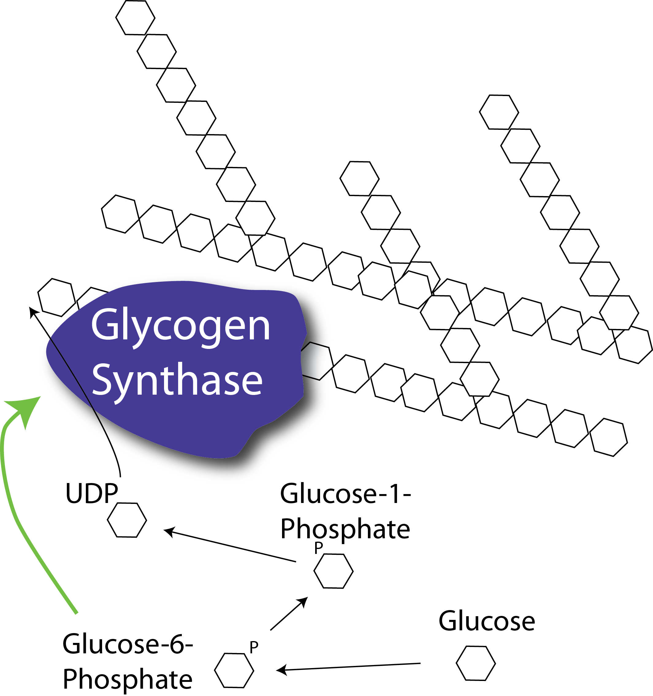
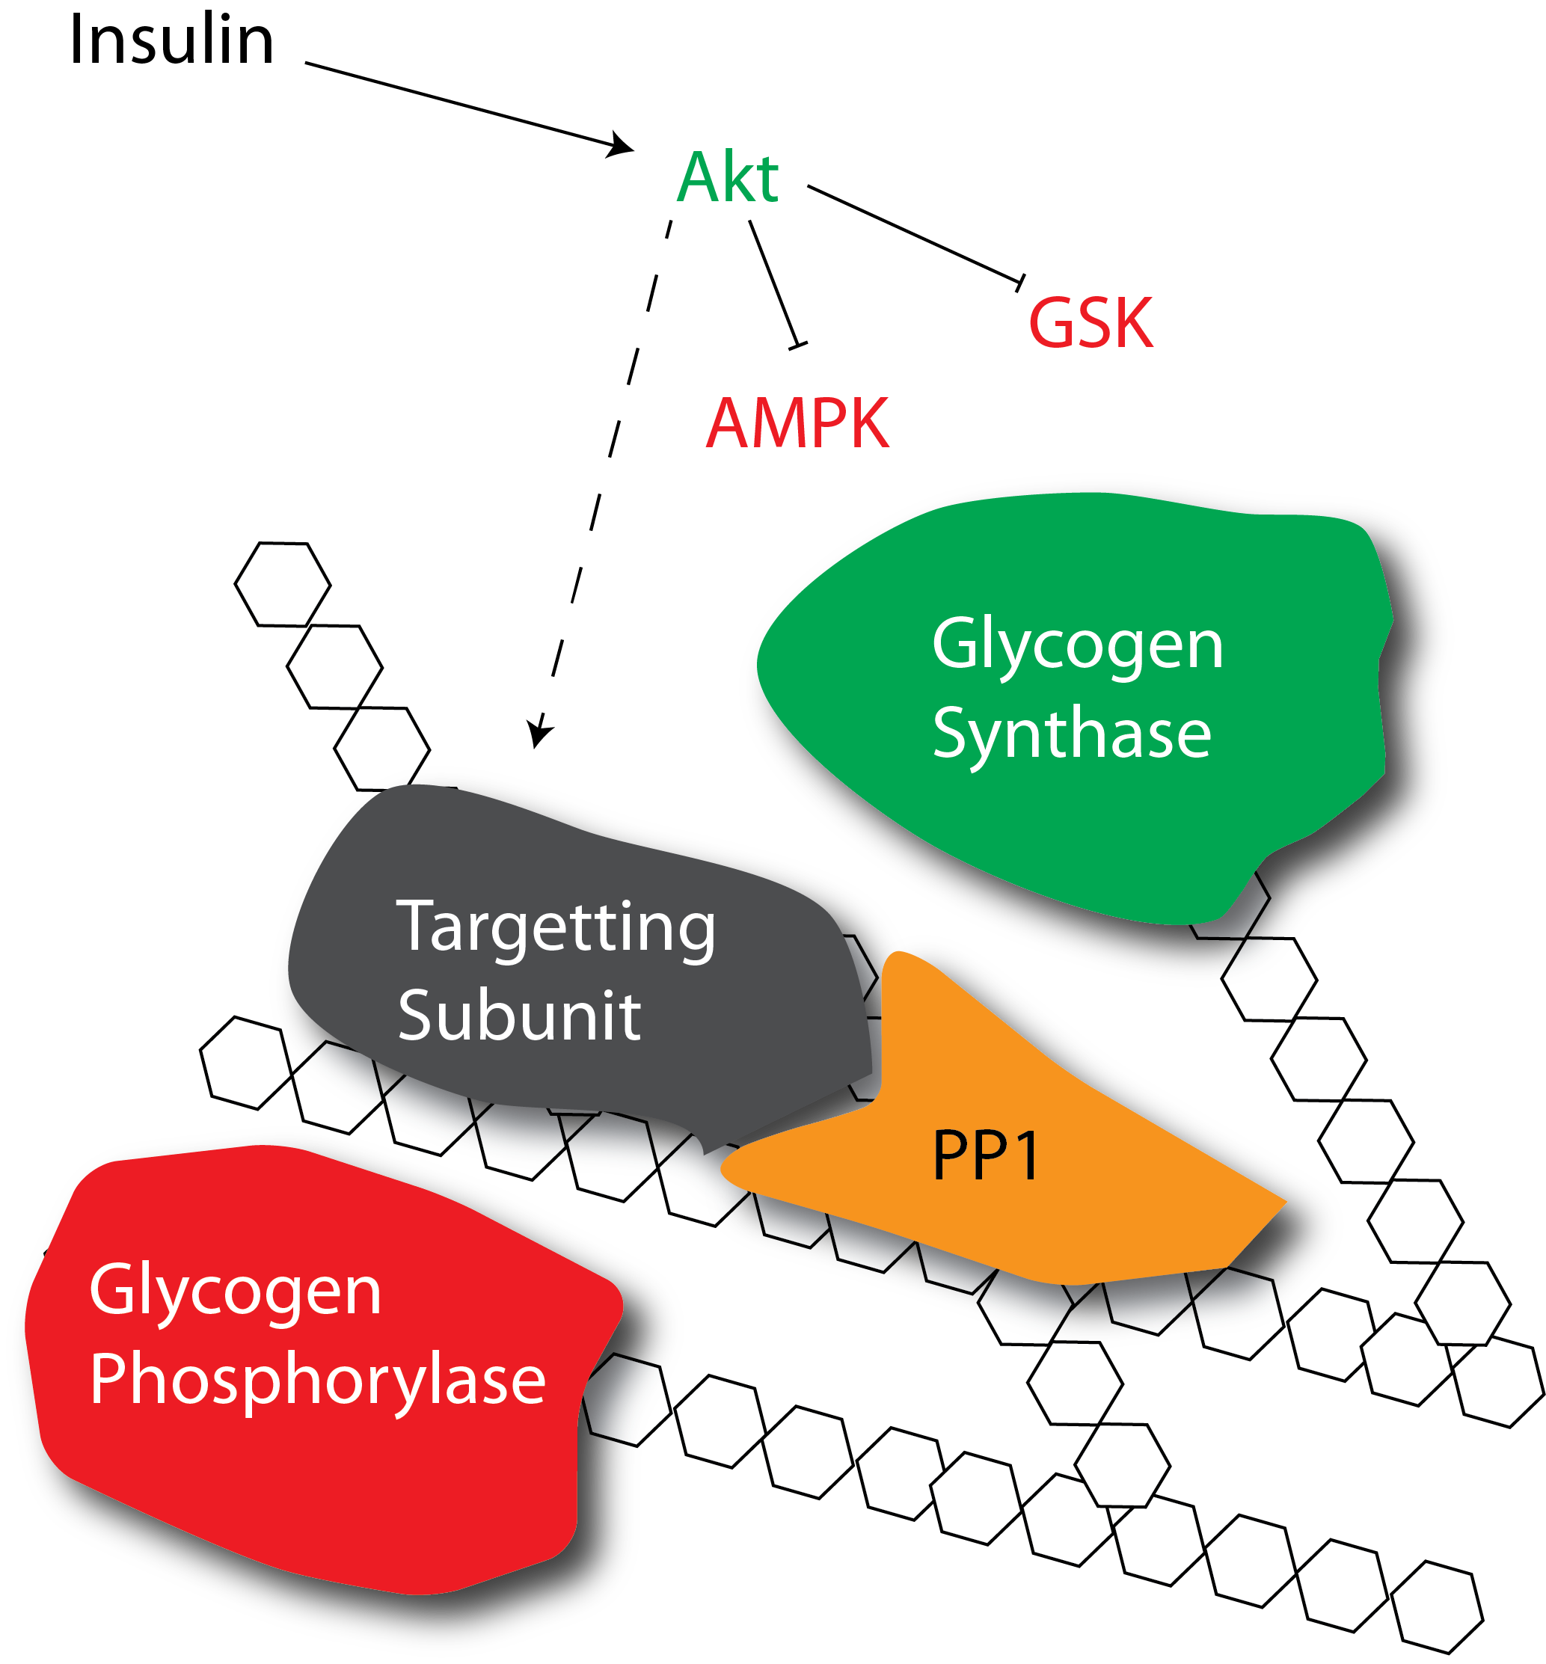
How does insulin promote glycogenesis?
Allosteric activation
Protein dephosphorylation
Notes:
First ask about which mediators are increased with insulin, or see what the allosteric activation of GS looks like

Slide 38
Glycogen storage has limited feedback to suppress glycogenesis
Glycogen supercompensation

Slide 39
Learning Objectives
Understand how glycogen synthesis and glycolysis are regulated by glycolytic intermediates.
Describe the importance of glycogen branching in both the storage and release of glucose from glycogen.
Explain how protein phosphorylation can regulate glycogen synthase and glycogen phosphorylase
Understand the roles of insulin, adrenaline and glucagon in glycogen storage
Explain how glycogen storage diseases can occur and how this results in different pathophysiologies depending on the type of GSD

